Slide 1
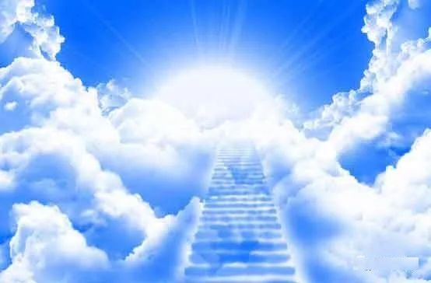
寶座
The Throne
詞、曲：林婉容

Slide 2
天上有個榮耀的寶座
其上坐著亙古常在者
威嚴 尊貴 公義 慈愛
天使天軍侍立寶座前
聽祂命令 遵行祂旨意
俯伏敬拜 晝夜不停
In the heav'nly realm there is a throne,
On it sits the Ancient of Days,
Awesome, mighty, flowing with grace,
And a host of angels at His throne
Carry out His will and sing Him praise,
Humbly serving through night and day.

Slide 3
天上有個榮耀的寶座
其上坐著亙古常在者
威嚴 尊貴 公義 慈愛
天使天軍侍立寶座前
聽祂命令 遵行祂旨意
俯伏敬拜 晝夜不停
In the heav'nly realm there is a throne,
On it sits the Ancient of Days,
Awesome, mighty, flowing with grace,
And a host of angels at His throne
Carry out His will and sing Him praise,
Humbly serving through night and day.

